Slide 1
第十一章 城市机动车污染控制

Slide 2
11.1 城市交通趋势及影响
11.2 Spark Ignition Engines
11.3 Compressed Ignition Engines
11.4 Advanced technology
Notes:
Thus, enforcement is the most critical component of an I/M program. It is more important than the test you use, more important than quality control, more important the standards. All of the technical and policy questions are irrelevant if you cannot insure that all of the subject vehicles show up to get tested when they are supposed to. While this may seem easy enough to do, in reality has proven very difficult.
Once you get the cars to show up, you need enforcement to make sure that the tests are conducted honestly, the repairs are effective, and the retests are also done honestly. Corruption can easily eliminate the benefits of the I/M program.
Finally, on old technology vehicles especially, you need a way to prevent readjustment - usually enrichment of the air-fuel mixture - after the retest. If vehicles are only clean for a day, then air quality benefits will not be realized.

Slide 3
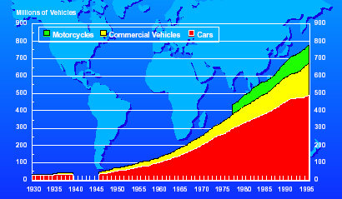
11.1 城市交通趋势及影响
11.1.1 世界机动车增长趋势

Slide 4
11.1.2 城市机动车污染现状
  随着经济的快速发展，我国汽车保有量连年高速增长
  汽车单车排放因子高
  机动车污染物排放总量大，城市机动车污染分担率高
  严重影响城市大气环境质量

Slide 5
11.1.3 中国机动车保有量增长情况
  近10年来，全国机动车保有量迅速增加，平均增长速度约14%
  重点大城市保有量增长更快，北京市92年以来平均增长速度超过20%
  机动车收入弹性系数研究表明：收入增长1%，机动车保有量增长1.02％～1.94％
  我国经济发展水平决定城市机动车保有量将会在一定时期内保持迅速增加

Slide 6
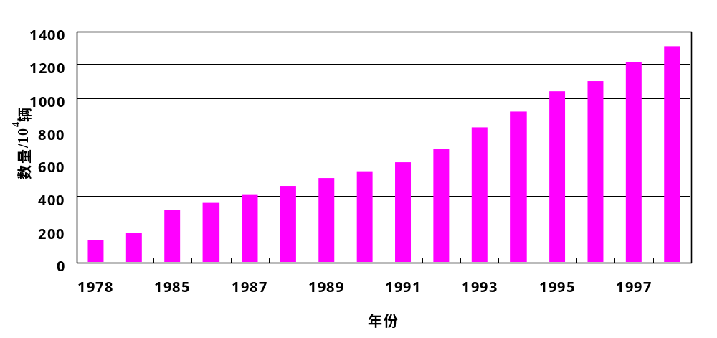
中国机动车保有量增长情况
Notes:
图表里可以得出我国的机动车保有量是逐渐增加，而且近几年的增长态势尤其迅猛，可以预料在未来几年内，其增长势头不会减弱。车辆的增多代表更多的尾气的排放，这也直接加重了环境的负担。

Slide 7
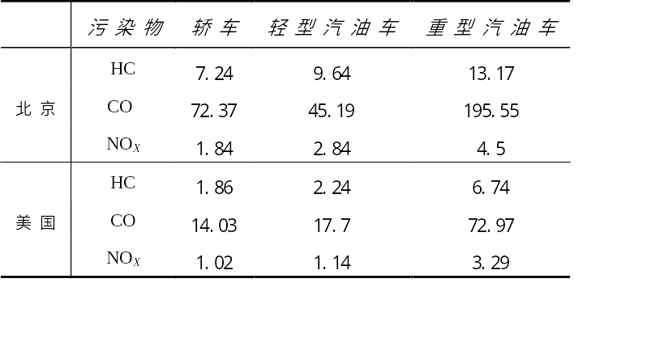
11.1.4 中美机动车排放因子比较

Slide 8
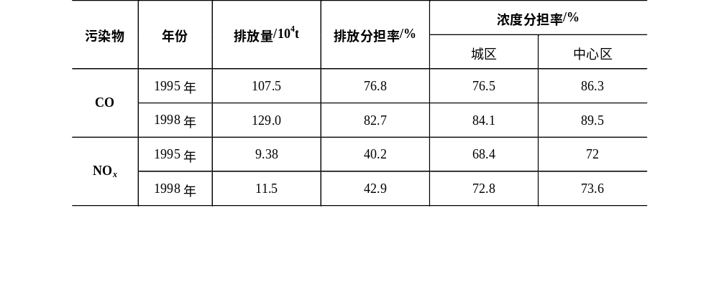
北京市机动车排放污染分担率

Slide 9
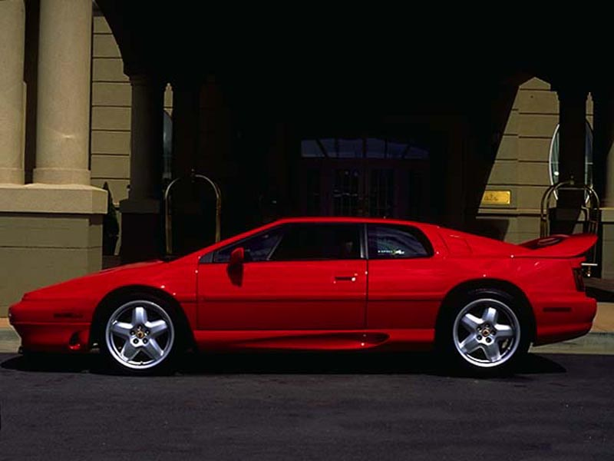
11.1.5 汽车污染物产生来源
油箱和化油器蒸发
HC的15%
排气管
所有的CO、NO_{X}、Pb和 HC的 60%
曲轴箱
HC 的 20%

Slide 10
11.2 Spark Ignition Engines
11.2.1 汽车动力系统 Theoretical Combustion
Carbon
Dioxide
Water
Vapor
Fuel
+
Oxygen
Energy动力
η_{et}
汽油车: 0.25~0.3
柴油车: 0.3~0.45
Ignition点火
Notes:
Under ideal, theoretical conditions, combustion would look like this. Ignition of a combination of fuel and oxygen would yield energy, with carbon dioxide and water vapor as side products. The goal of mobile source pollution control has been to force technology and the users of combustion equipment to come closer to this ideal. This theoretical combustion equation does not happen in the real world. In reality, many things are going on and many factors are influencing the process.

Slide 11
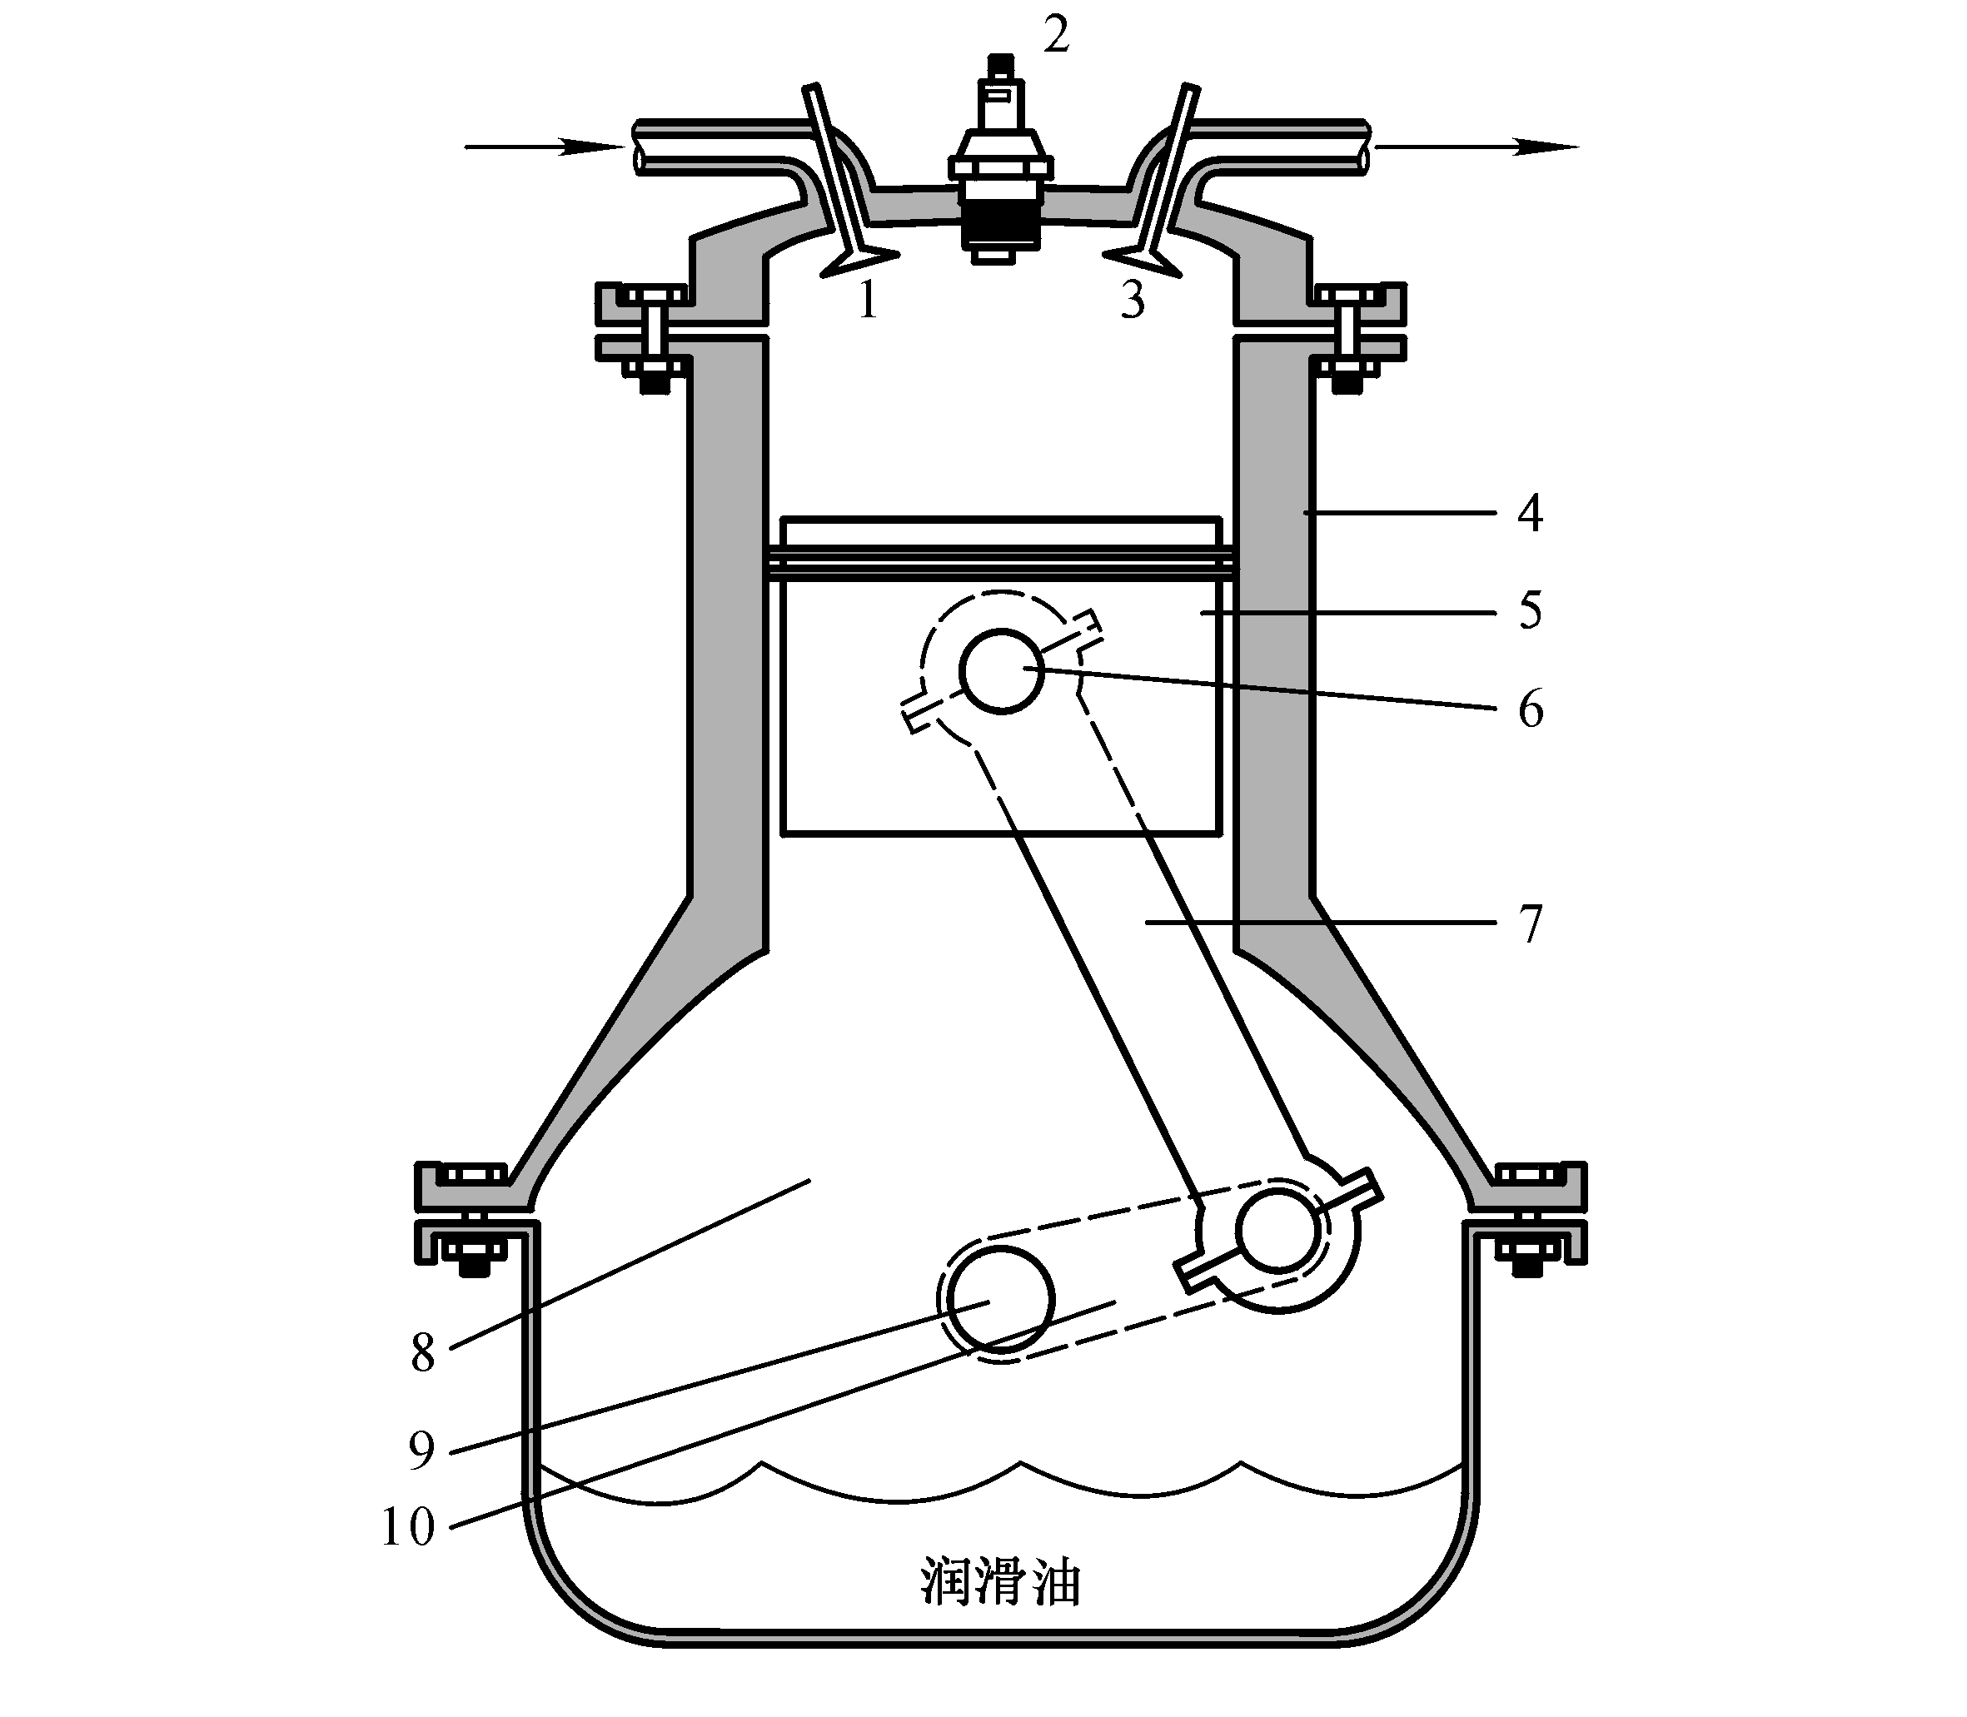
Engine
Cylinder
ε=(V_{c}+V_{d})/V_{c}
汽油机ε=6~10，而柴油机ε=16~24
Notes:
Besides tailpipe emissions, motor vehicles also pollute in other ways and some of these sources can be significant. Evaporative emissions and refueling losses are major sources of raw, unburned hydrocarbons released into the atmosphere. We estimate that in the U.S. - given very tight controls on tailpipe emissions - evaporative emissions contribute as much as half the excess emissions from vehicles!

Slide 12

Actual Combustion
尾气管排放物
Ambient Air
Real Fuel
Lead
Hydrocarbons
Carbon Monoxide
Oxides of Nitrogen
Carbon Dioxide
Particulates
Other pollutants
Water Vapor
Engine/Emission
Technology
Notes:
Actual combustion is much different from theoretical combustion. Instead of oxygen, we are dealing with air - a mixture of oxygen, nitrogen, and other gases and particles. The fuel is not a pure, simple compound but rather a complex mixture of hydrocarbons, sulfur, lead, and other substances that have a significant impact on emissions from vehicles. Because we need the energy produced by combustion to do useful work - in this case push a piston - we are combust gasoline under less than ideal conditions inside a cylinder. So, what comes out the tailpipe is not simply water and CO2 but rather a complex mix of pollutants that result from these less than ideal operating conditions.

Slide 13
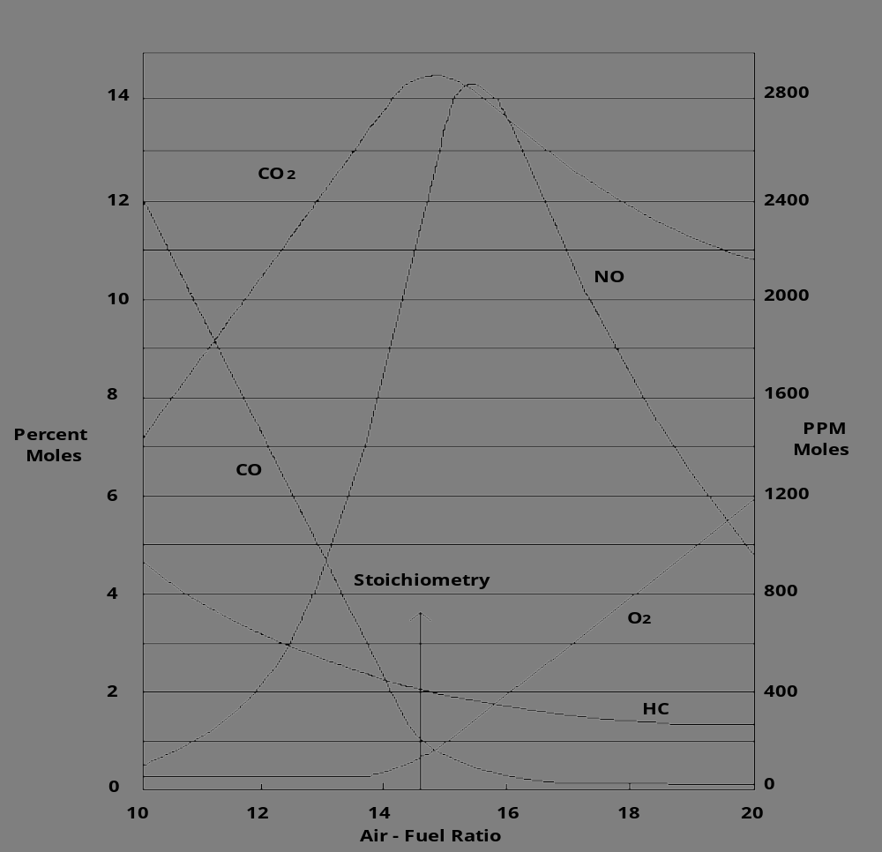
Stoichiometry等当点
汽油(C₈H₁₇)理论空燃比: 约14.7
CO:
局部不均匀
残余HC
Notes:
Another way to look at ideal combustion is to consider the ideal air fuel mixture. At an air-fuel mixture of 14.5:1, stoichiometry, the operation of the combustion engine is optimized - taking into consideration the full range of factors we are trying to control. Note, however, that at 14.5:1, the HC and CO emissions are reduced by the NO emissions increase dramatically. This fundamental trade off in emission control makes reducing pollution from combustion engines very difficult.

Slide 14
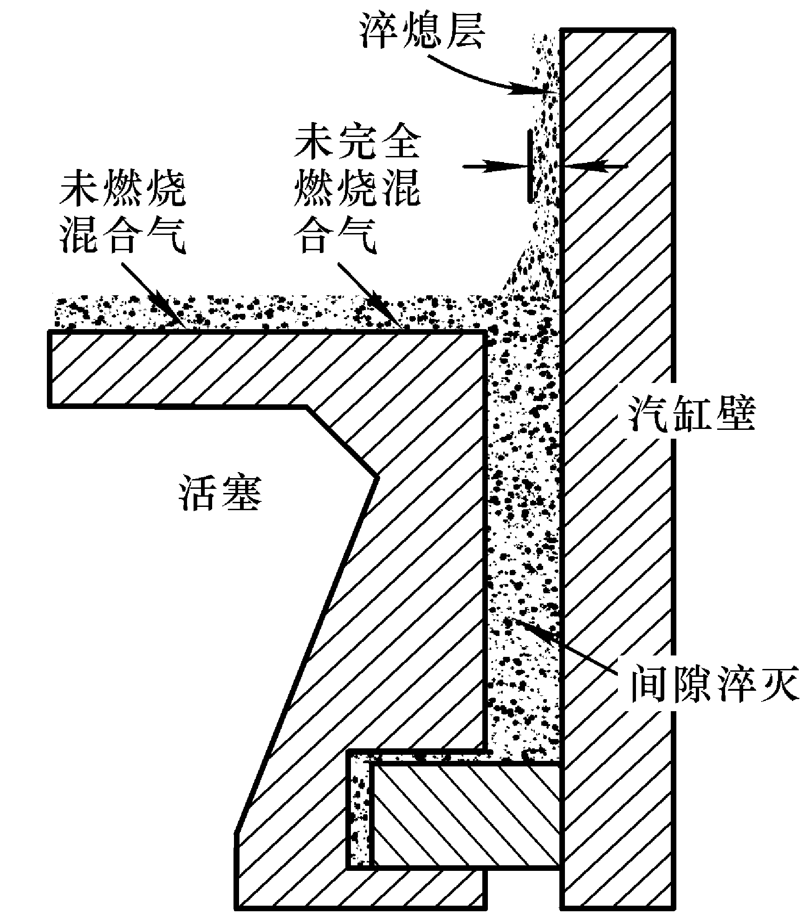
HC:
不完全燃烧
壁面猝灭
油膜吸附
Notes:
Another way to look at ideal combustion is to consider the ideal air fuel mixture. At an air-fuel mixture of 14.5:1, stoichiometry, the operation of the combustion engine is optimized - taking into consideration the full range of factors we are trying to control. Note, however, that at 14.5:1, the HC and CO emissions are reduced by the NO emissions increase dramatically. This fundamental trade off in emission control makes reducing pollution from combustion engines very difficult.

Slide 15
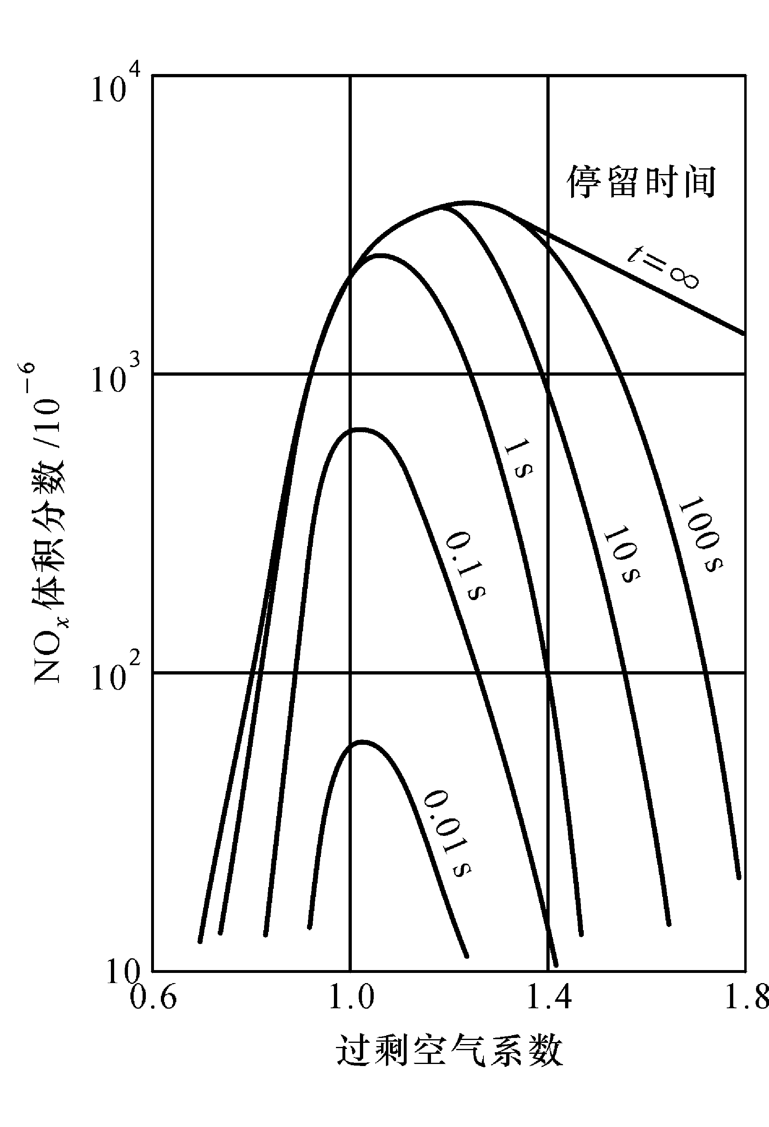
NO_{x}:
Thermal NO
Prompt NO
Fuel NO
Notes:
Another way to look at ideal combustion is to consider the ideal air fuel mixture. At an air-fuel mixture of 14.5:1, stoichiometry, the operation of the combustion engine is optimized - taking into consideration the full range of factors we are trying to control. Note, however, that at 14.5:1, the HC and CO emissions are reduced by the NO emissions increase dramatically. This fundamental trade off in emission control makes reducing pollution from combustion engines very difficult.

Slide 16
汽油车 Other Emissions
Refueling Losses
displaced vapors
Evaporative Emissions
diurnal, running losses, hot soak
Other Emissions
brake linings, tire wear, fluid leaks
Crankcase Losses
due to "blow-by"
Notes:
Besides tailpipe emissions, motor vehicles also pollute in other ways and some of these sources can be significant. Evaporative emissions and refueling losses are major sources of raw, unburned hydrocarbons released into the atmosphere. We estimate that in the U.S. - given very tight controls on tailpipe emissions - evaporative emissions contribute as much as half the excess emissions from vehicles!

Slide 17
讨论1: 汽车污染产生
汽油发动机空燃比对污染物排放有何影响?
汽车排放的污染物有哪些?
汽油车污染排放包括哪些环节?
这些环节排放哪几种污染物?
-------------目标是提高燃烧效率, 降低排放
Notes:
下面一页留给您备用

Slide 18
New Cars Are Cleaner and More Efficient
+100%
注: MPG:英里/加仑
HC
CO
NO_{x}
MPG
-70%
-85%
-85%
Percent change compared to new cars of the 1970 Model Year
Notes:
There is hope however, Since we started controlling emissions from motor vehicles back in the 1960s, we have seen a tremendous reduction in the emissions from motor vehicles while improving fuel economy at the same time. This benefit has come from new vehicle standards.

Slide 19
排放性能的劣化 Conventional carburetor car
HC emissions of LDGV
2.5
y = 0.0114x + 0.6433
R
2
= 0.1748
2
(g/km)
1.5
Emission Factor
1
0.5
0
0
20
40
60
Accumulated Mileage(10
4
km)

Slide 20
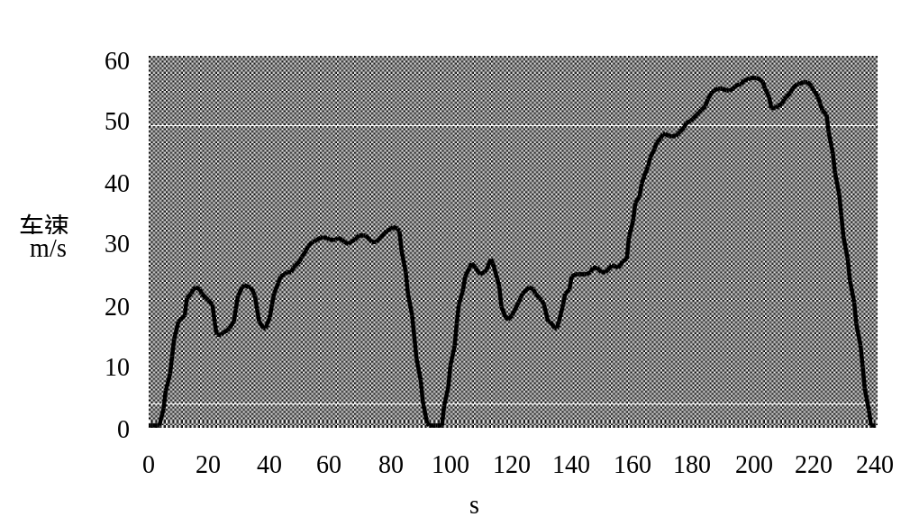
行驶工况的影响 (IM240)
Notes:
Transient testing is the best general purpose tailpipe emission test that we have developed to date. New vehicle standards are a function of a transient loaded test so it stands to reason that such a test is going to be a good choice. By transient we mean two things: first, the speed at which the vehicle is operated during the course of the test varies. Second, the load the vehicle is subjected to varies as well. The other feature of transient tests that contributes to their effectiveness is time. Instead of being a snapshot, they measure emissions at different speeds and loads over the course of a significant amount of time. By comparison, other tailpipe emission test result are usually based on only 5-10 seconds of measurement (under steady state conditions). The remote sensing test is less than 1 second usually under unknown conditions.
This driving trace for the IM240 shows the speed/time relationship over the course of the test.

Slide 21
汽油车行驶工况与排放
1. 怠速, 减速时CO, HC排放高, 浓度约为:
CO: 1.0%～6%; HC: 400～3000ppm
NO_{x}: 10～100ppm
2. 加速, 定速时NO_{x}高, 浓度约为:
NO_{x}: 1000～4000ppm
CO: 0.5％～3.0%; HC: 200～600ppm
加速时, 碳烟约为: 0.005g/m³
Notes:
下面一页留给您备用

Slide 22
讨论2: 影响排放的因素
汽车使用中哪些因素对排放影响大?
如何考虑汽车行驶工况对排放的影响?
(如制定标准时, 计算排放量时)
Notes:
下面一页留给您备用

Slide 23
主要控制技术
前处理: 无铅汽油(0.013g/L), 低硫汽油和柴油(1200ppm～50ppm)
废气再循环(EGR): 20%循环, 降低NO_{x}约60%, 但油耗增加3%
机内控制: 发动机设计
表面积/容积 越小越好; 电子控制技术; 多气门技术
机外控制技术: 热反应器, 催化反应器(氧化, 还原--三效)
Notes:
下面一页留给您备用

Slide 24
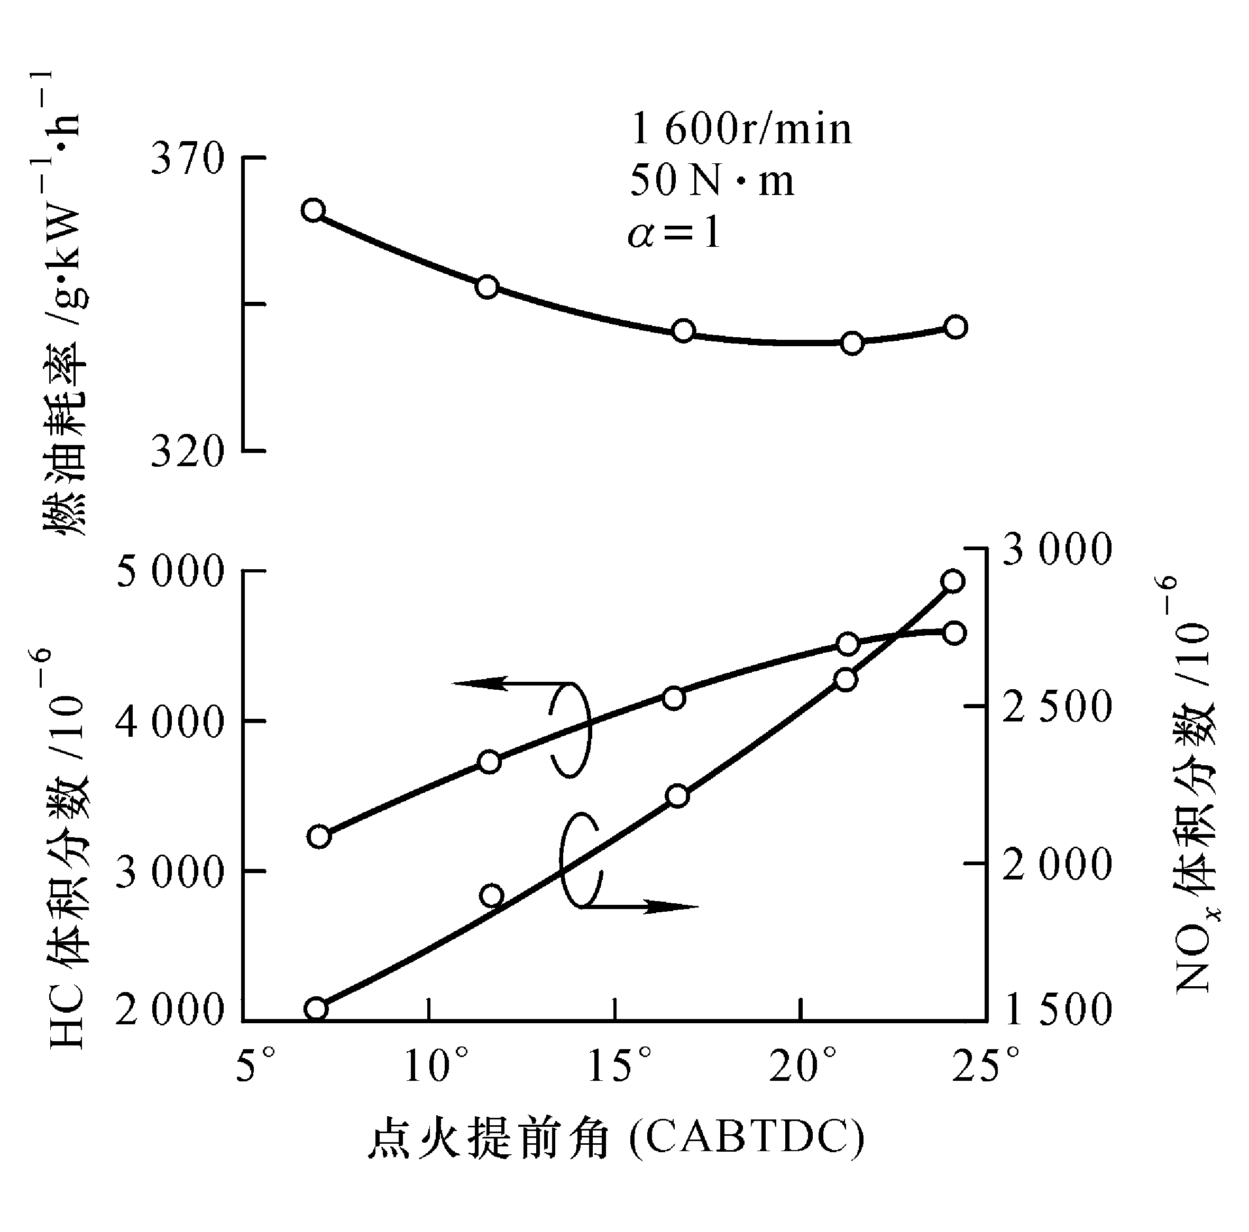
改进点火系统
Notes:
下面一页留给您备用

Slide 25
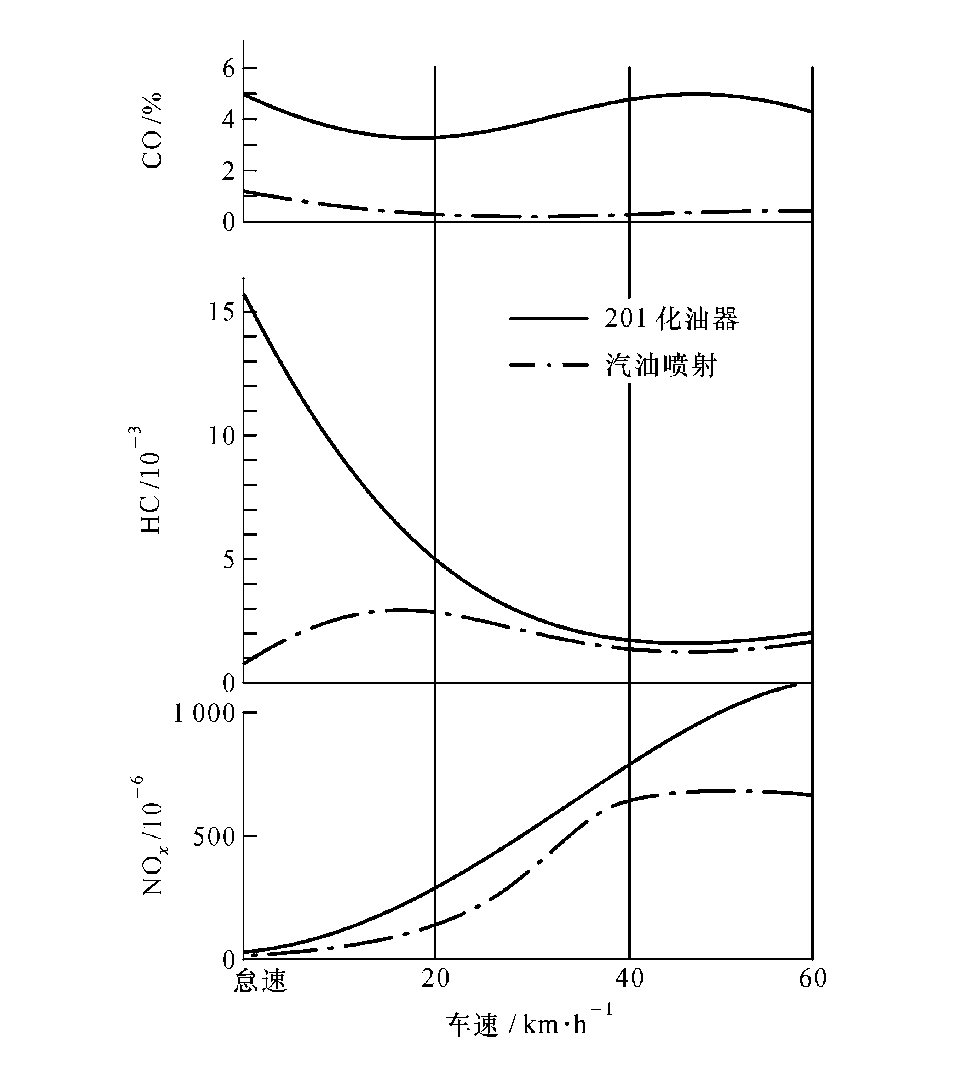
电控燃油
喷射系统
Notes:
下面一页留给您备用

Slide 26
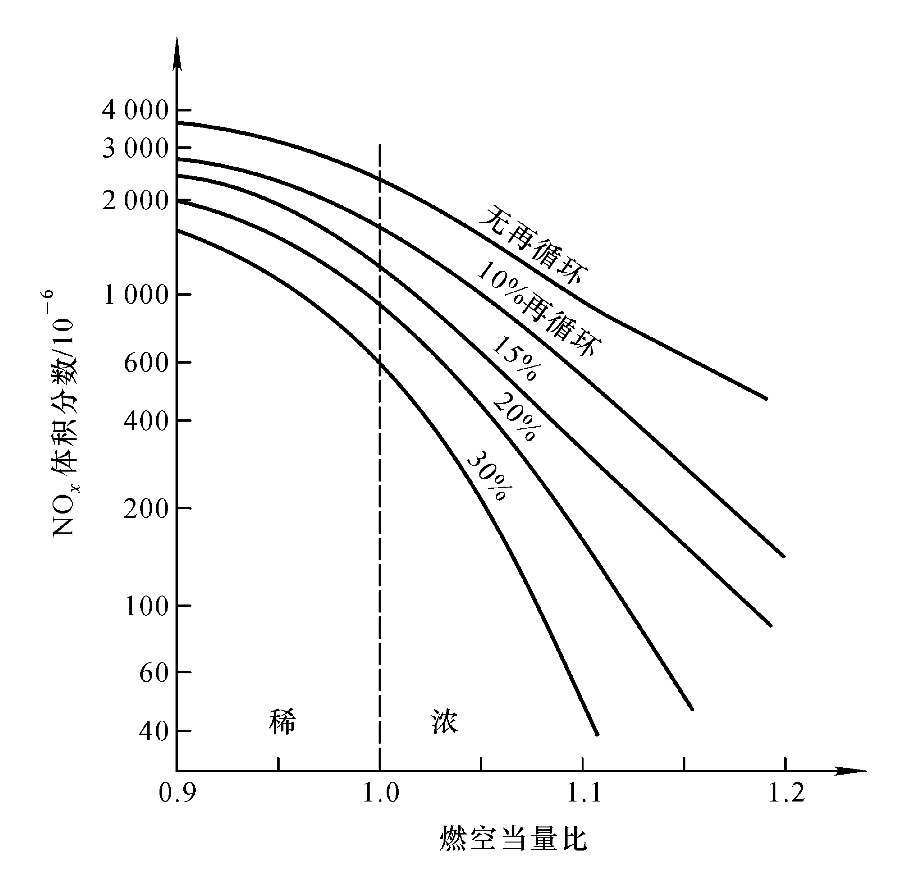
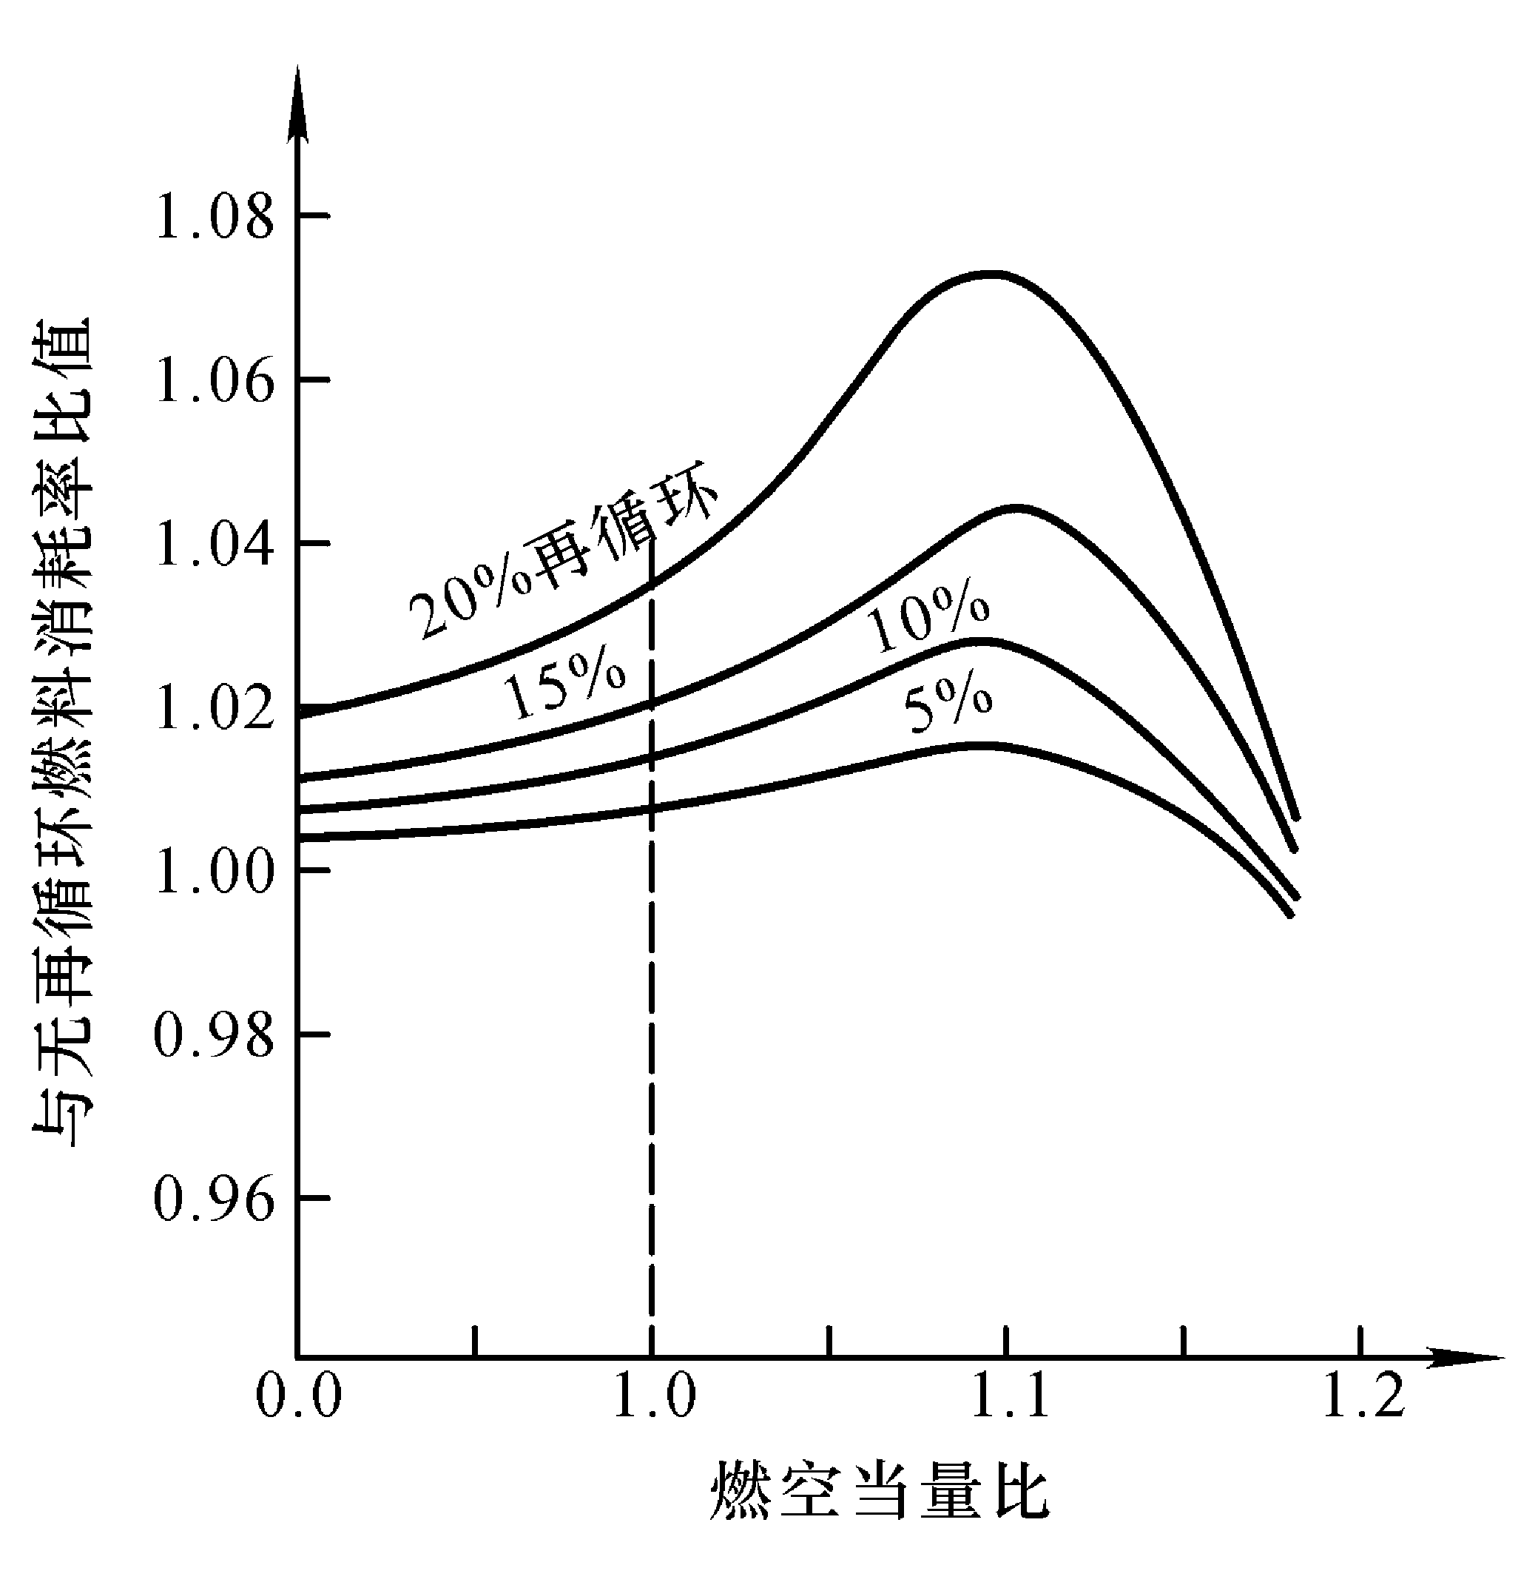
废气再循环(EGR)
Notes:
下面一页留给您备用

Slide 27
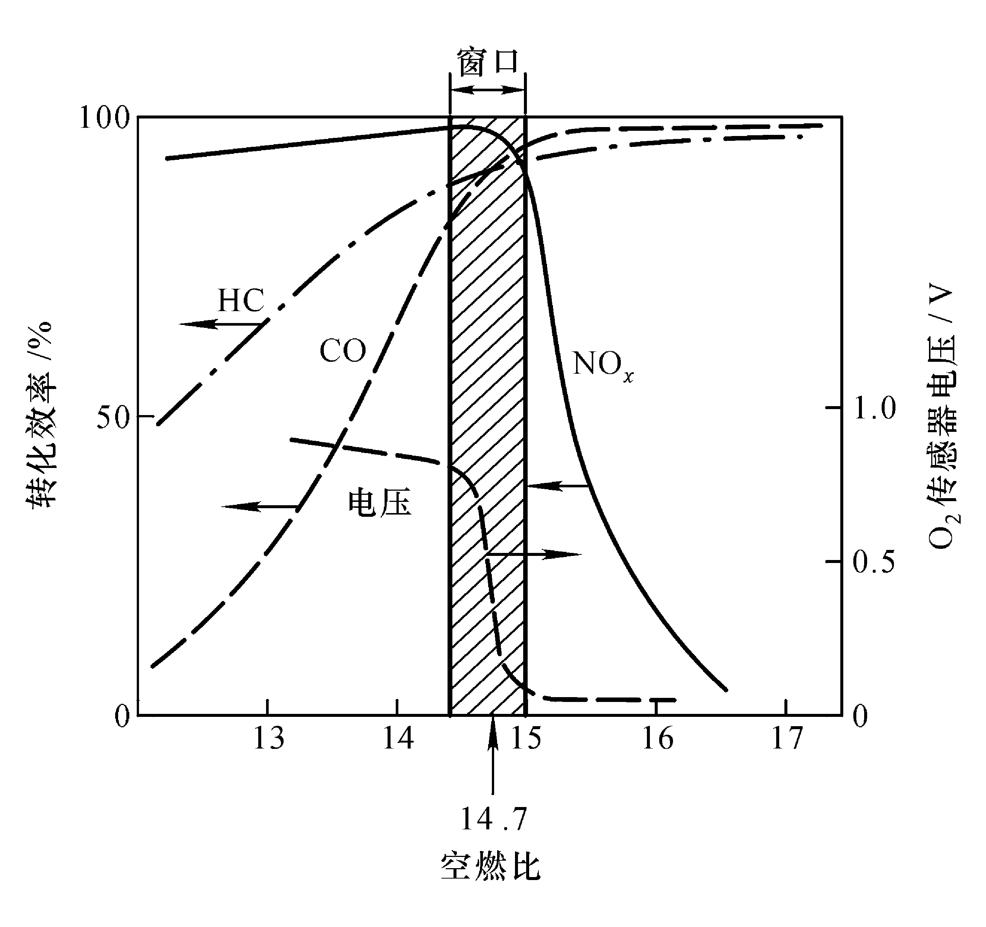
三效催化净化技术(TWC)
同时净化3种污染物: CO, HC, NO_{x}
只能在很窄的空燃比窗口工作: 闭环电控燃油喷射技术
Notes:
下面一页留给您备用

Slide 28
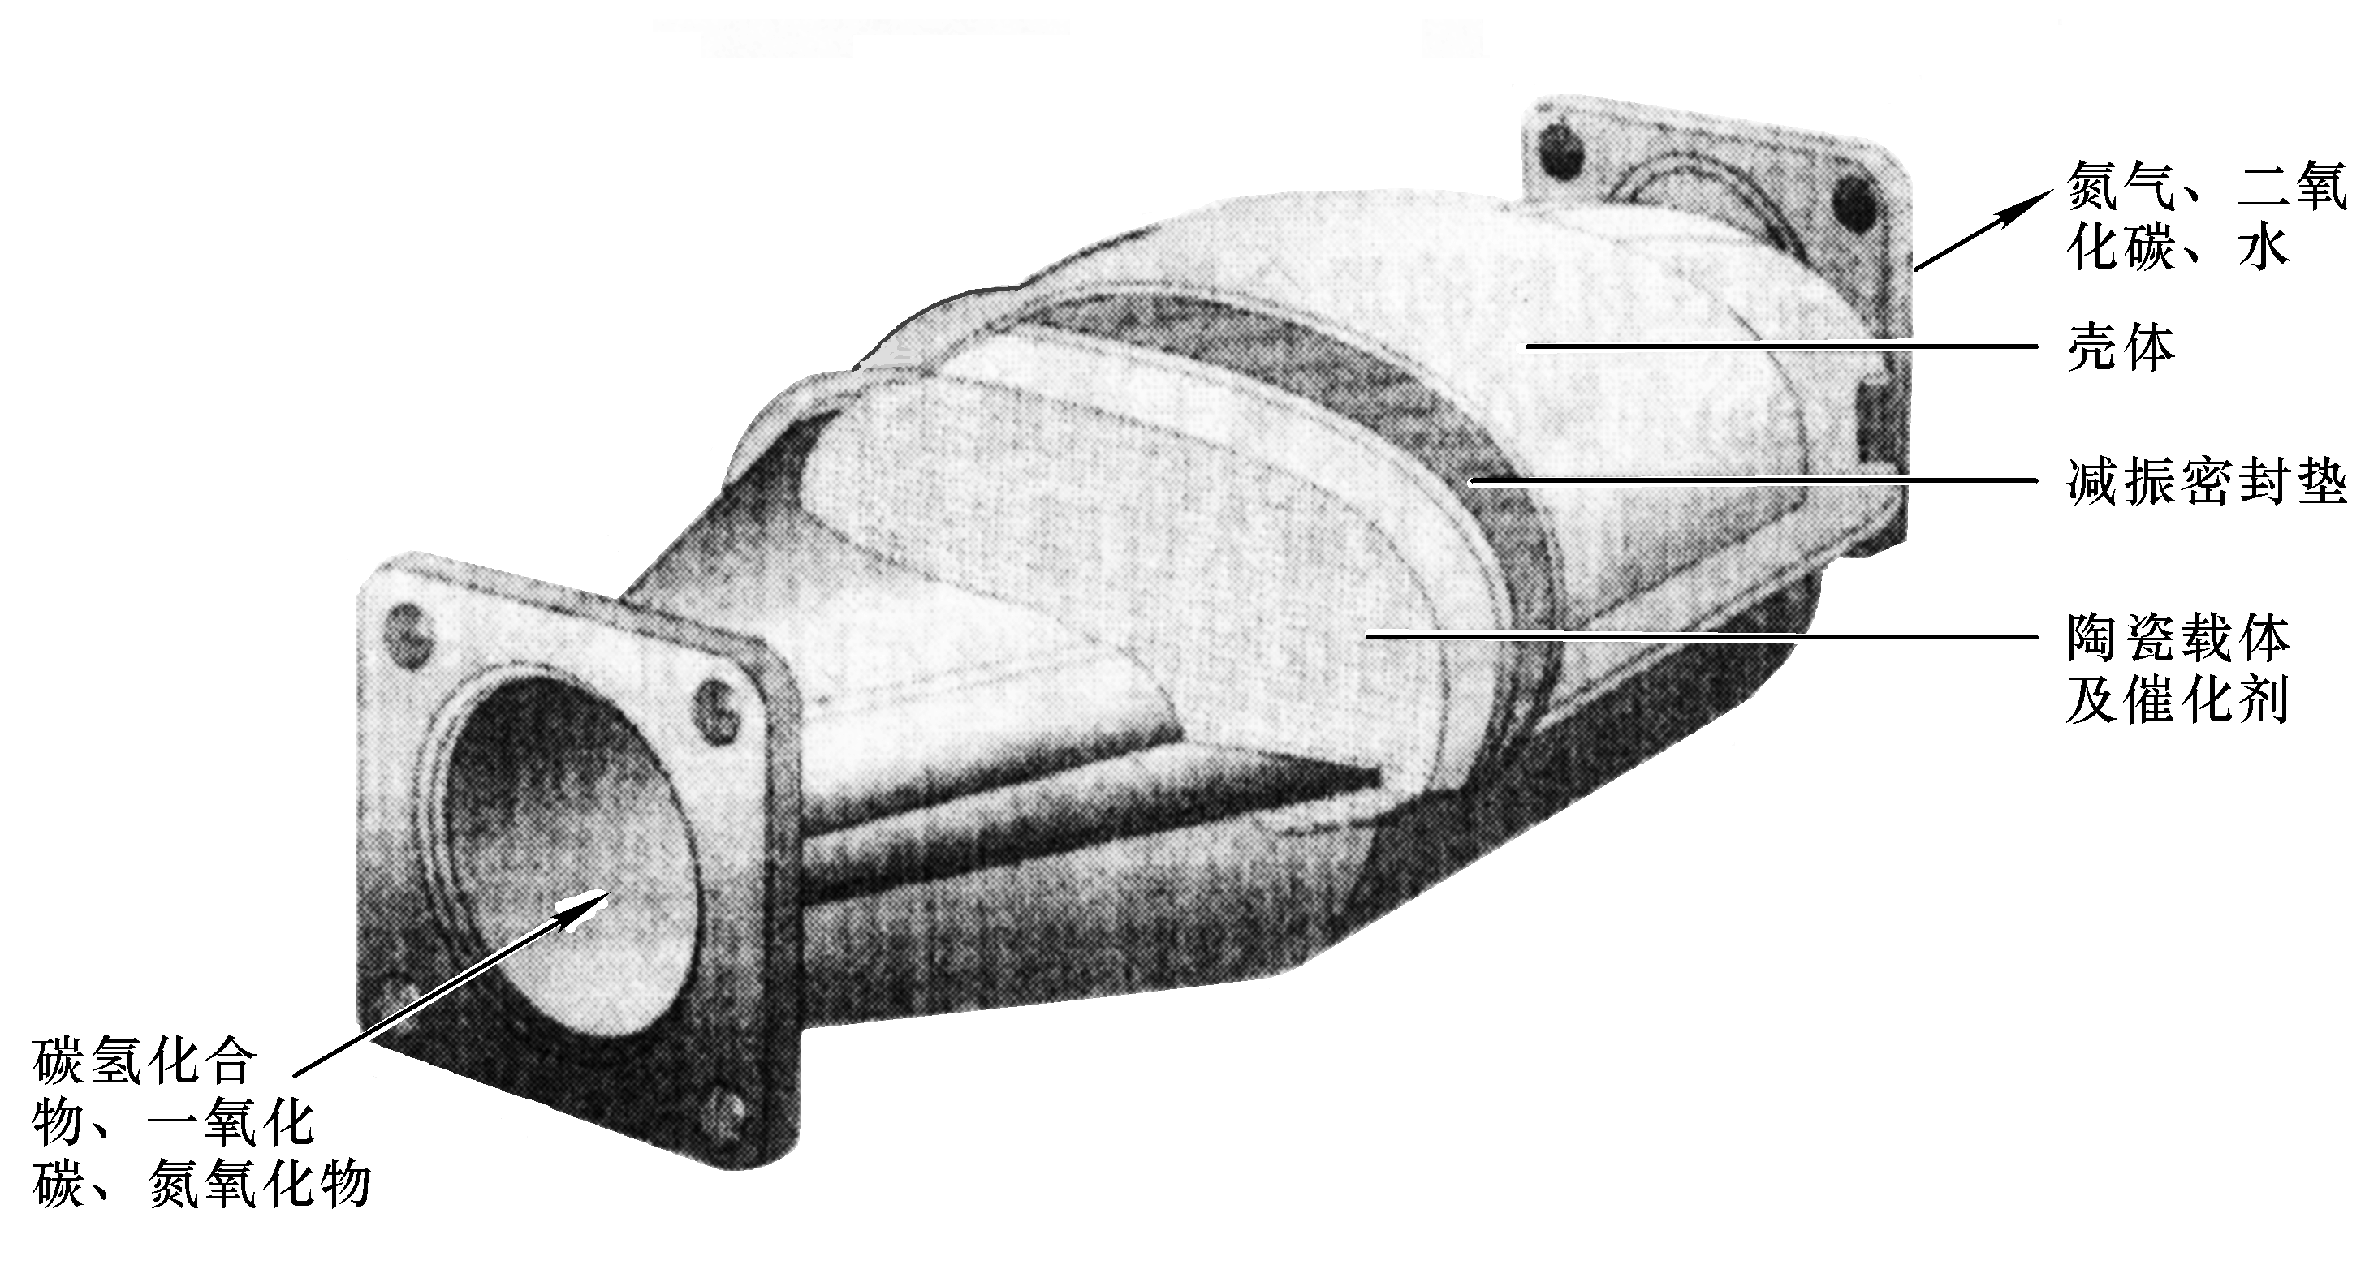
三效催化净化技术(TWC)
主要使用贵金属+陶瓷载体, Pt, Rd, Pd
寿命要求80000～160000km, 防中毒很关键!
Notes:
下面一页留给您备用

Slide 29
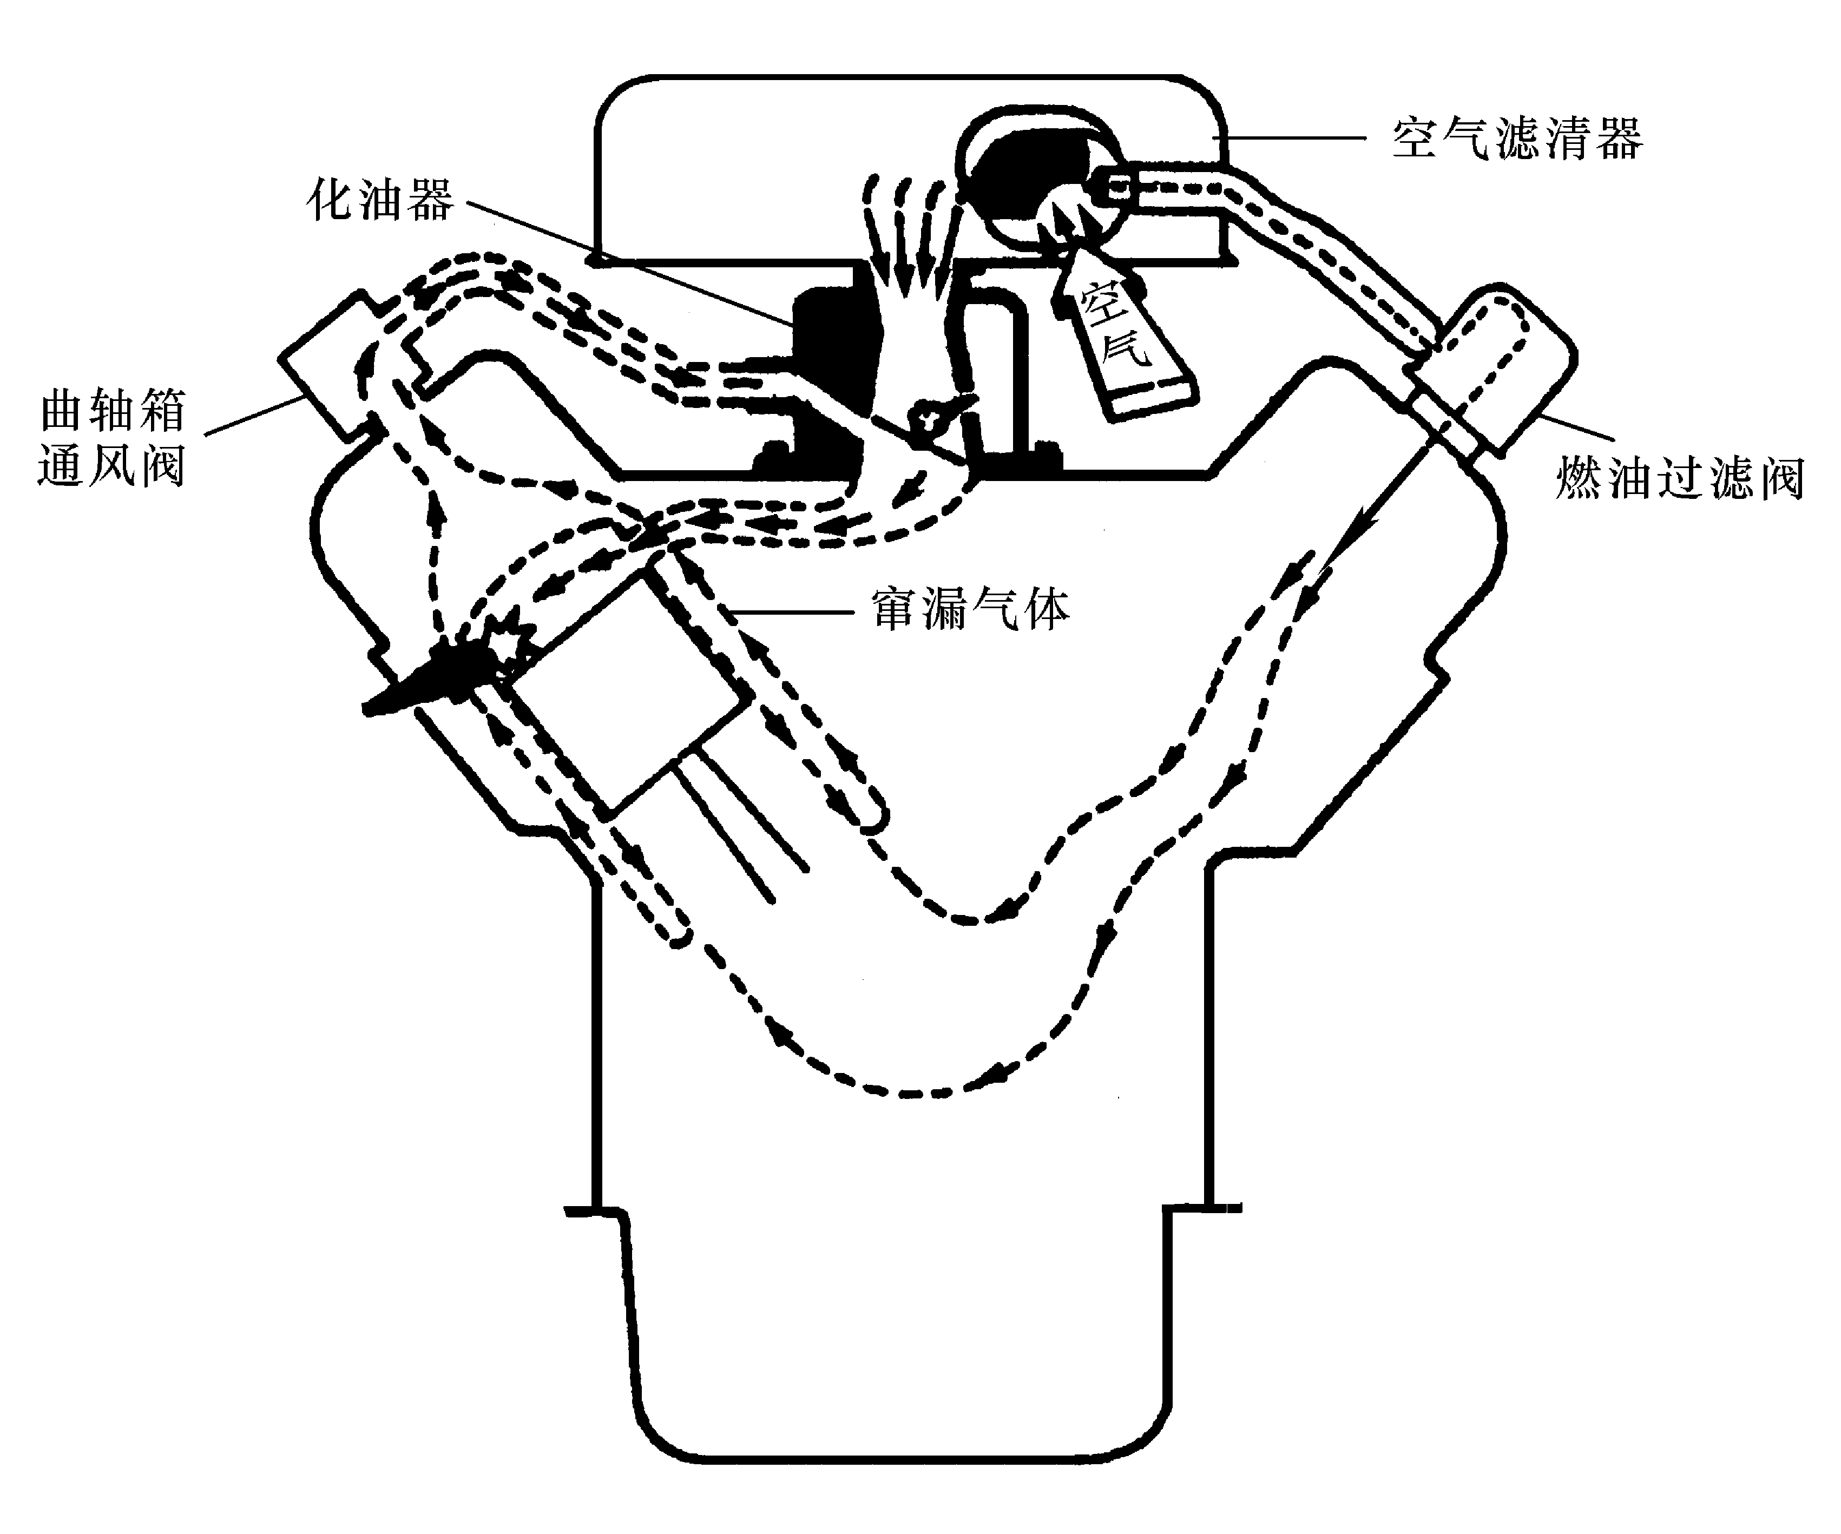
曲轴箱(crankcase)排放控制
Notes:
下面一页留给您备用

Slide 30
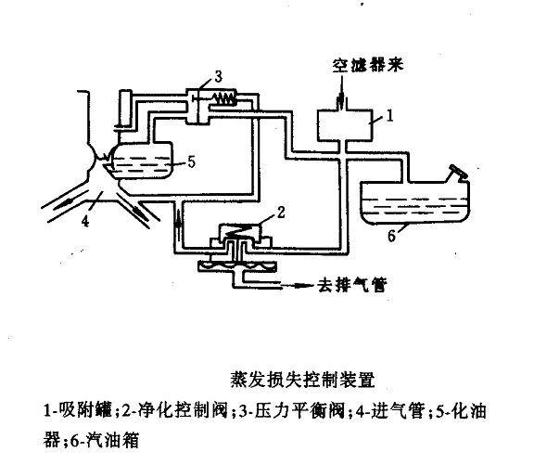
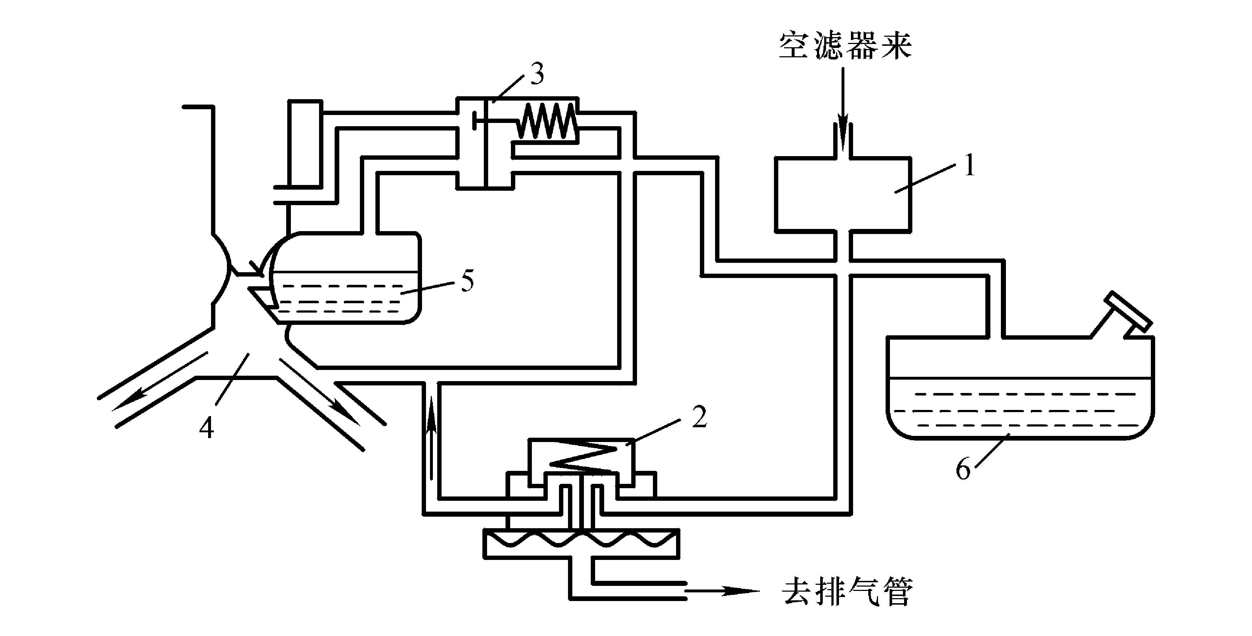
Evaporative emission control
Notes:
下面一页留给您备用

Slide 31
中国的机动车污染控制
Clean Air Strategy Developed
  Complete Lead Phase Out by 2000
  Introduce Euro 1(1992 Vintage,Catalyst Based) Standards for Cars & Lt.Trucks in 2000 (Beijing,Shanghai 1999)
  Heavy Truck Standard,Euro 1,also in 2001(2000 in Beijing)
  I/M Pilot Being Developed in Shanghai

Slide 32
讨论3: 控制技术
目前最主流的汽油车排放控制技术组合是什么?
三效催化技术有哪几个关键?
车用汽油哪些指标对排放最重要?
-------------更新的标准导致更新的技术
Notes:
下面一页留给您备用

Slide 33
11.3 Compressed Ignition Engines
汽油, 柴油发动机的区别
汽油发动机燃烧为预混火焰, 柴油为扩散火焰
柴油发动机压缩比高, 热效率高30％～50%
柴油发动机以喷油雾化方式燃烧, 产生碳烟较多
柴油车经济性好, 马力大, 最先实现3升车
汽油车加速性好, 正在开发缸内直喷发动机技术
Notes:
下面一页留给您备用

Slide 34
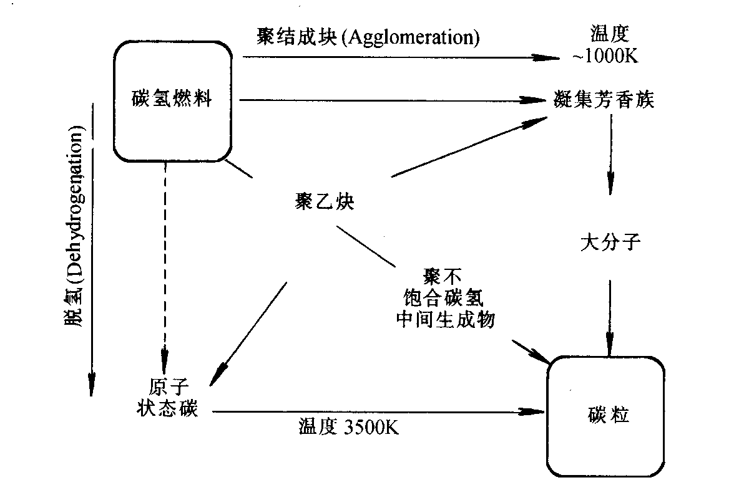
Formation path of Soot
Notes:
下面一页留给您备用

Slide 35
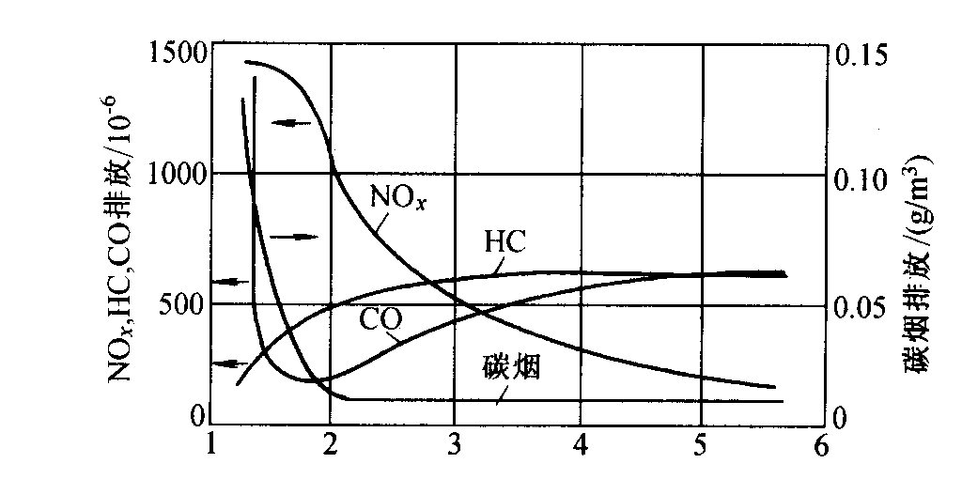
Pollutants and Air-fuel ratio
NO_{x},HC,CO排放的体积分数/10⁻⁶
碳烟排放/g·m⁻³
Notes:
下面一页留给您备用

Slide 36
柴油车行驶工况与排放
1. CO总是很低, 约0.1%
2. 减速, 怠速时HC相对较高, 浓度约为400ppm
此时NO_{x}较低, 约为30～70ppm
3. 加速, 定速时NO_{x}高, 浓度约为:
NO_{x}: 800～2500ppm
此时HC: 90～200ppm
4. 加速时碳烟最高, 约为0.30g/m³
Notes:
下面一页留给您备用

Slide 37
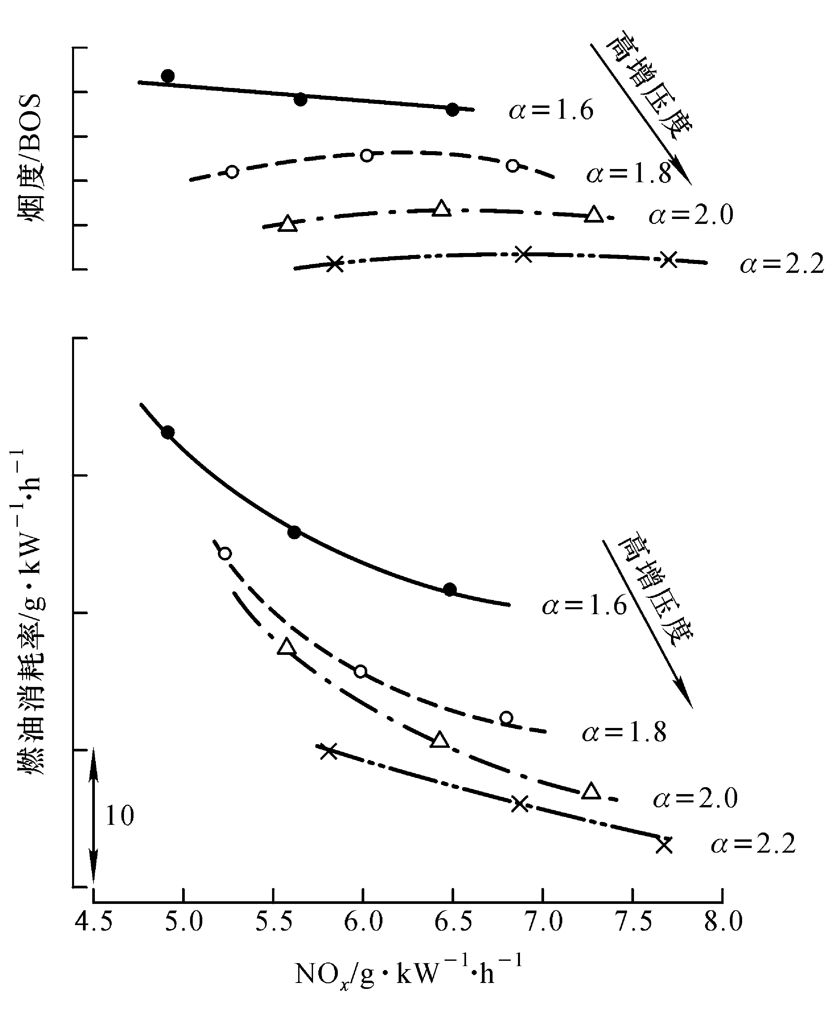
Turbo-charge and Emission
Inter-cooler
Notes:
下面一页留给您备用

Slide 38
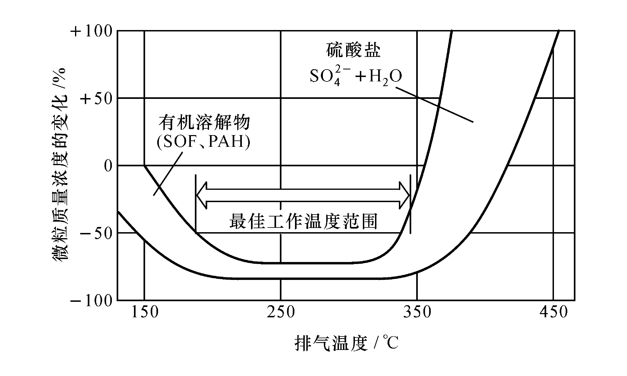
Oxidation catalyst
Notes:
下面一页留给您备用

Slide 39
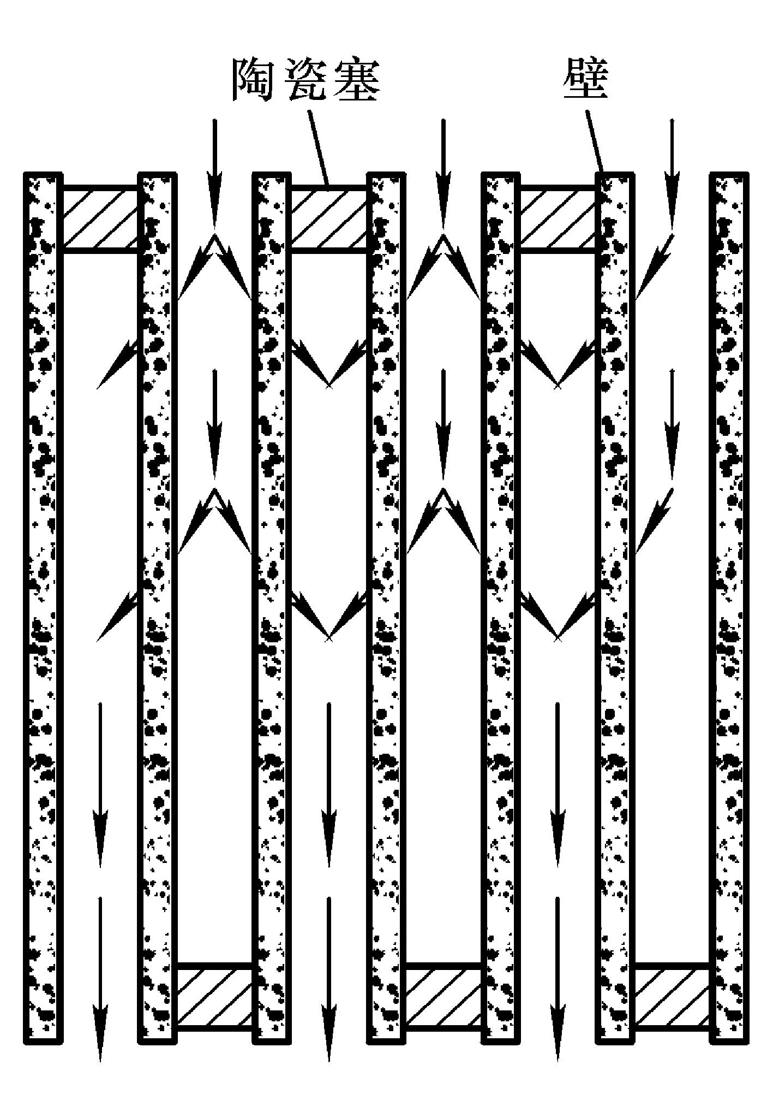
Particulate Trap
Notes:
下面一页留给您备用

Slide 40
11.4 Advanced Technology
最新控制技术
冷启动排放控制
  催化剂需要一定的起燃温度
  前级催化剂
  电加热催化剂
车载诊断技术(OBD)
  自动检测诊断车辆排放系统状况
  自动提示故障
  存储信息有利于维修
Notes:
New standards, however, will not solve all of your problems. The volume of new car sales and the rate of scrappage of old technology cars will have great influence on emission trends. Motor vehicle manufacturers have improved the quality and longevity of vehicles such that average age of vehicles in the U.S. fleet has been getting older slowly but surely. If conditions are such that old decrepit vehicles are kept in the fleet, their air quality impact will be huge. Another consideration relates to which standards and how they are enforced. Certification and compliance programs are expensive and complex to administer. The benefits of tight standards may be lost if the government infrastructure and resources do not exist to effectively manage a compliance program. Strong authority is required to permit enforcement - ultimately, denying a manufacturer the ability to sell a non-complying vehicle or engine. International manufacturers don’t want to have to deal with different standards and certification programs in each country. Local manufacturers don’t want to be left a competitive disadvantage to foreign competitors. Thus, allowing certificates from other countries may make it easier and cheaper to ensure and achieve compliance (by sharing information across national boundaries).
One final thought, how will the cost of additional controls impact fleet turnover? In a rapidly growing economy, this may not be an important consideration. Nevertheless, a substantial increase in the cost of new vehicles as a result of new emission standards will affect demand.

Slide 41
未来汽车技术
稀燃缸内直喷汽油发动机
柴油车PM及NO_{x}机外净化技术
混合动力技术
燃料电池汽车技术
Notes:
New standards, however, will not solve all of your problems. The volume of new car sales and the rate of scrappage of old technology cars will have great influence on emission trends. Motor vehicle manufacturers have improved the quality and longevity of vehicles such that average age of vehicles in the U.S. fleet has been getting older slowly but surely. If conditions are such that old decrepit vehicles are kept in the fleet, their air quality impact will be huge. Another consideration relates to which standards and how they are enforced. Certification and compliance programs are expensive and complex to administer. The benefits of tight standards may be lost if the government infrastructure and resources do not exist to effectively manage a compliance program. Strong authority is required to permit enforcement - ultimately, denying a manufacturer the ability to sell a non-complying vehicle or engine. International manufacturers don’t want to have to deal with different standards and certification programs in each country. Local manufacturers don’t want to be left a competitive disadvantage to foreign competitors. Thus, allowing certificates from other countries may make it easier and cheaper to ensure and achieve compliance (by sharing information across national boundaries).
One final thought, how will the cost of additional controls impact fleet turnover? In a rapidly growing economy, this may not be an important consideration. Nevertheless, a substantial increase in the cost of new vehicles as a result of new emission standards will affect demand.

Slide 42
讨论4: 未来控制技术
传统汽车技术还有哪些不足?
现代汽车排放控制技术的难点?
将来的汽车革命可能是什么?
----------除了汽车, 还需要配套条件和适用性
Notes:
下面一页留给您备用

